Slide 1
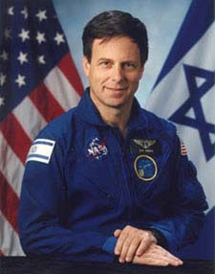
בית ספר אזורי ממ"ד תורני גוש עציון
חטיבה בוגרת בנות

Slide 4
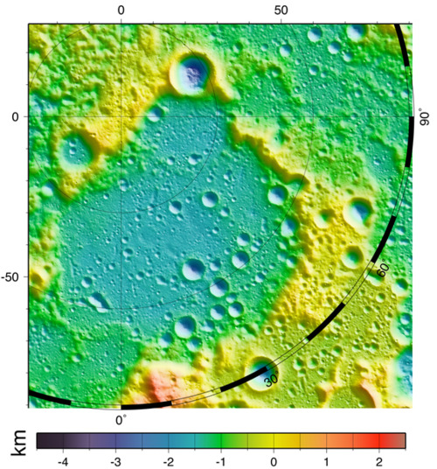
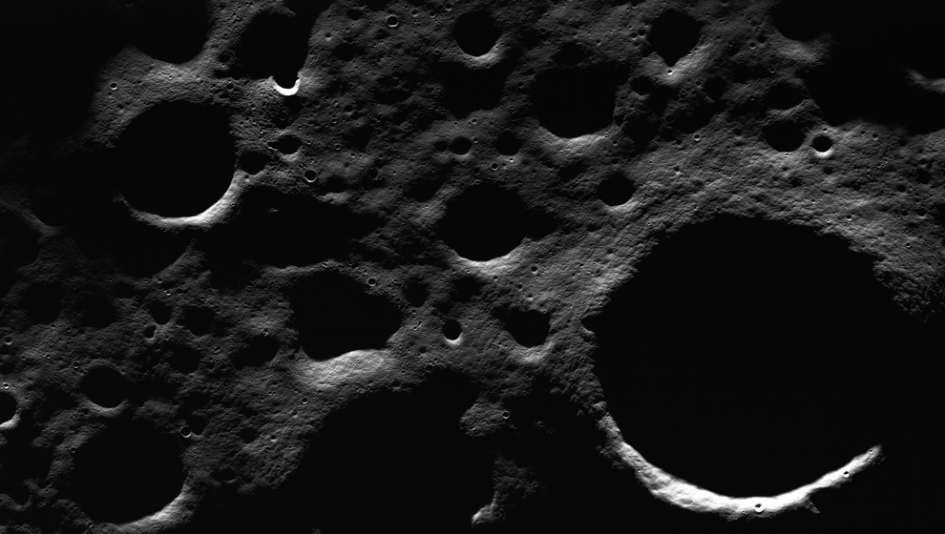

Slide 5
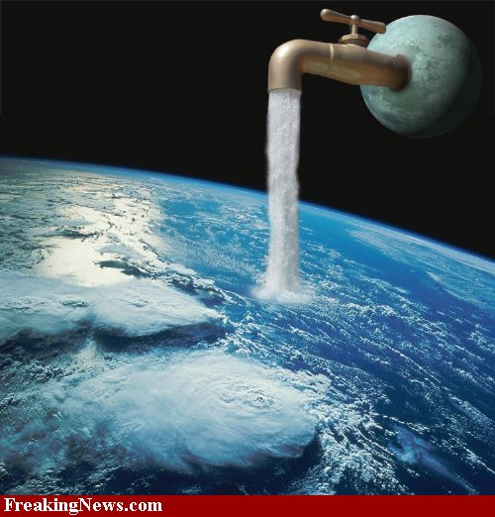

Slide 6
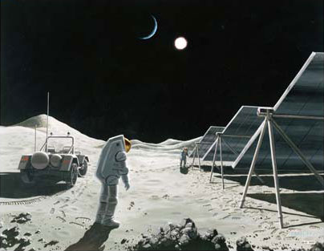

Slide 7
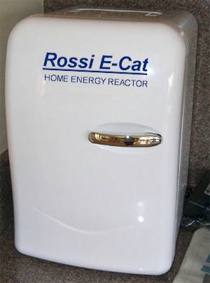
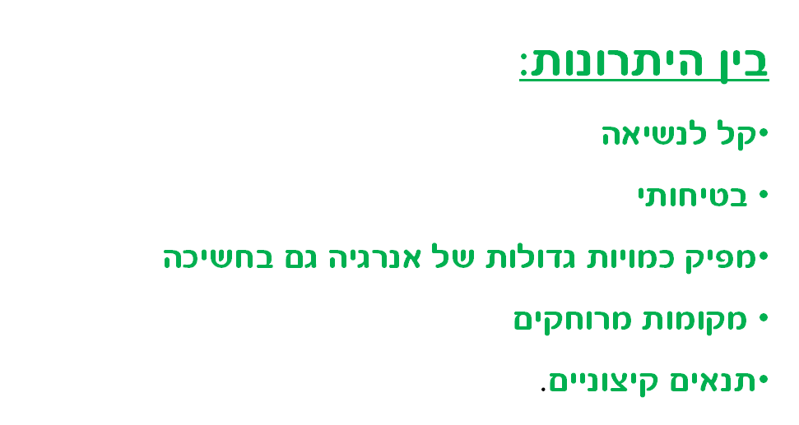
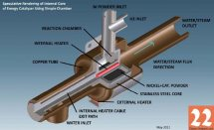

Slide 8
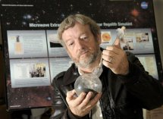
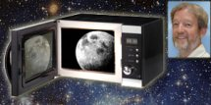

Slide 9
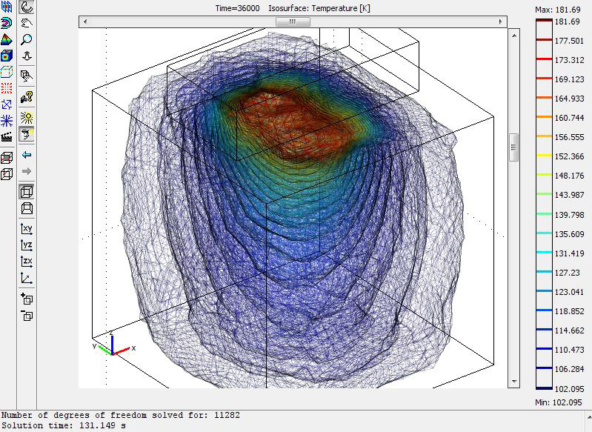
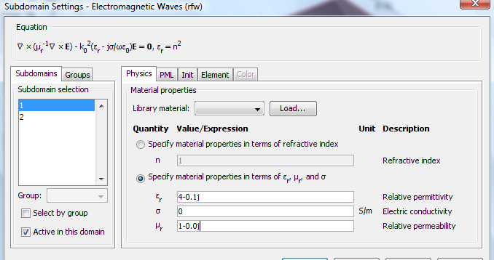
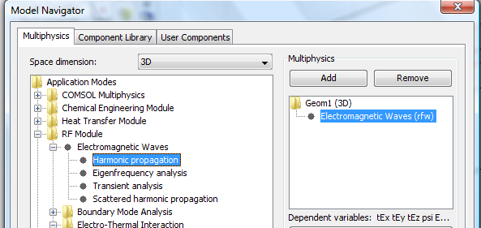

Slide 10
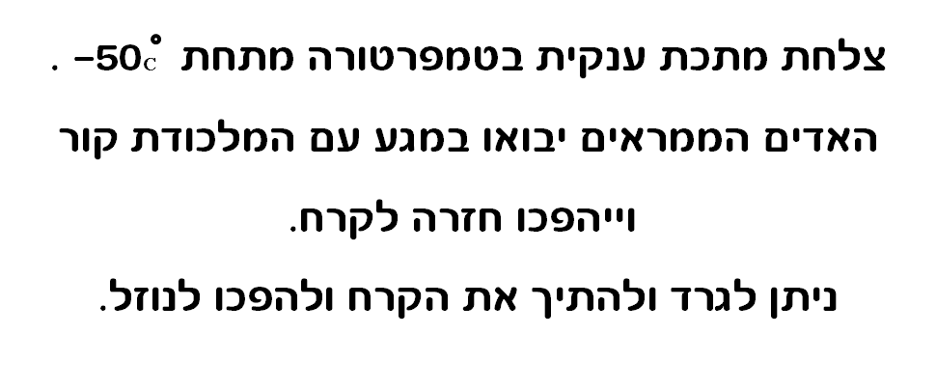
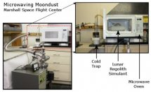

Slide 11
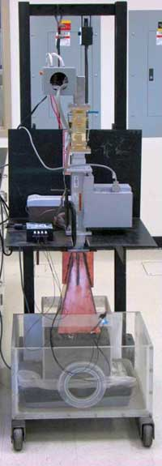

Slide 12
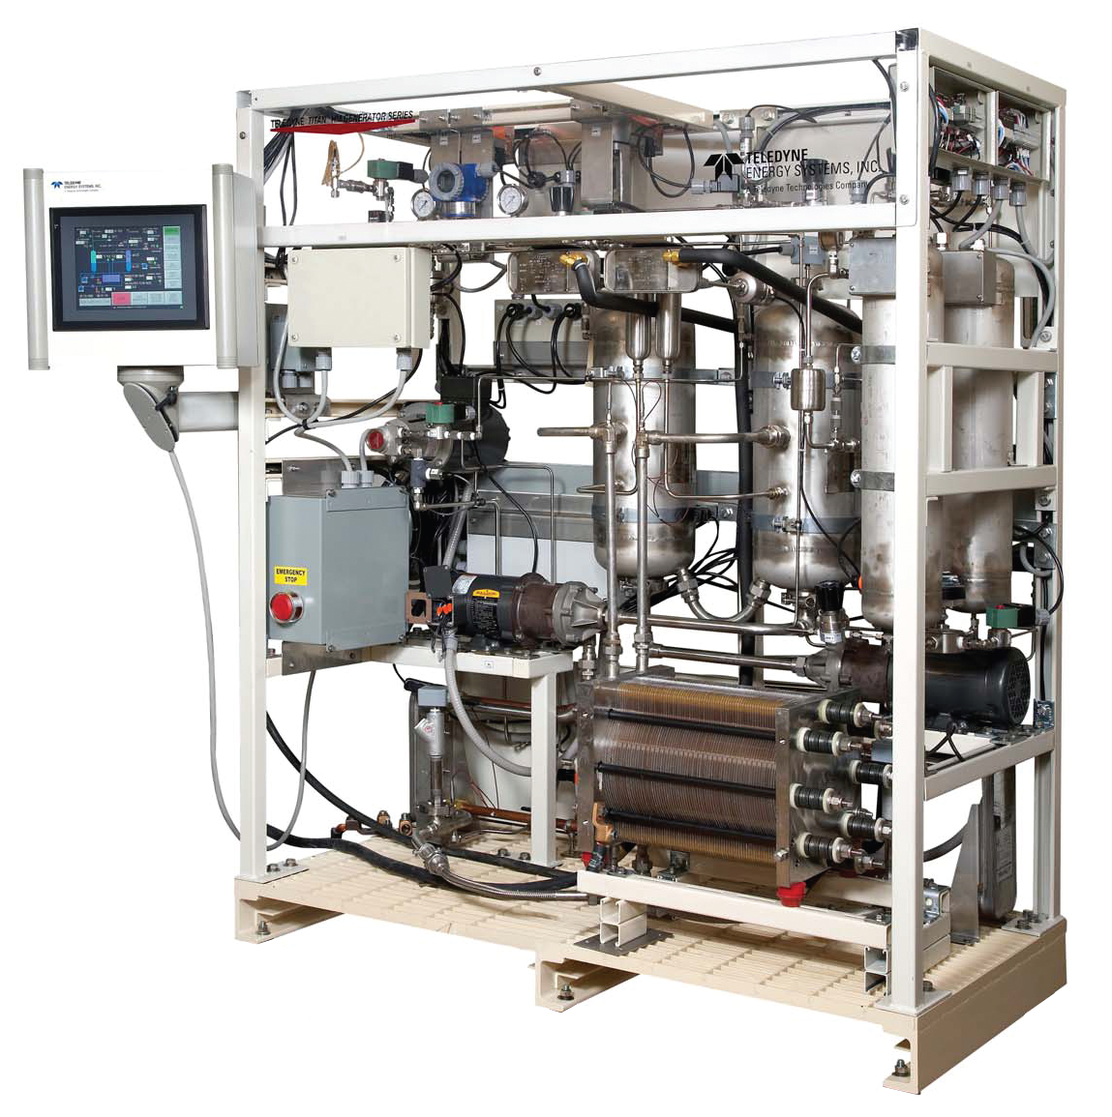
2H2(g) + O2(g)

Slide 13
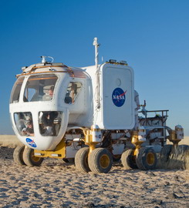
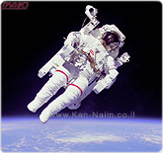
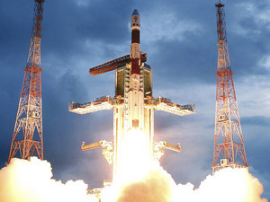
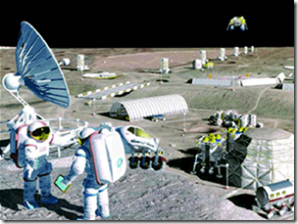

Slide 14
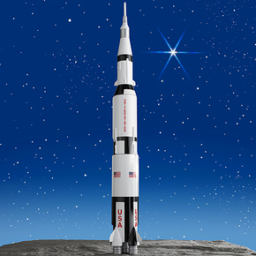
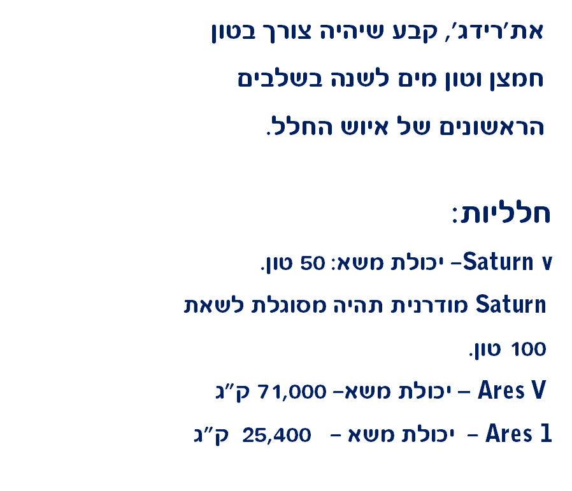
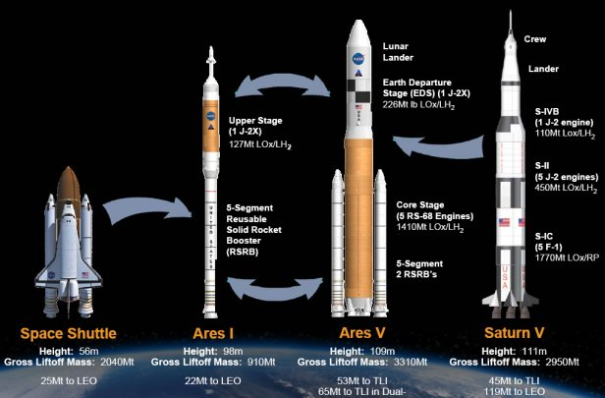
Saturn v

Slide 15
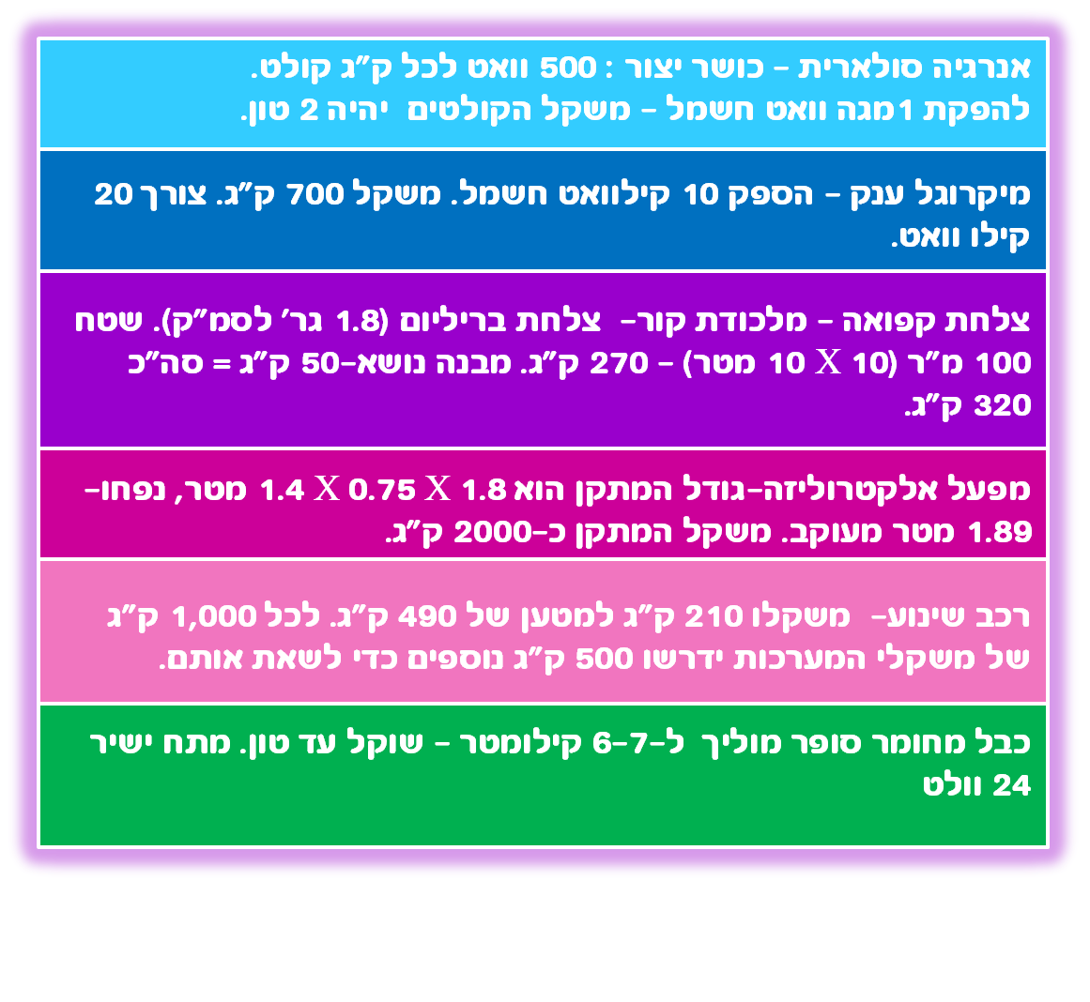

Slide 18
הפעילות
0
1
2
3
4
5
6
7
8
9
10
משך השנים

Slide 19
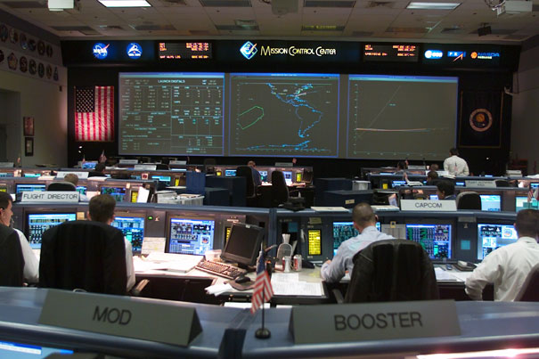

Slide 21
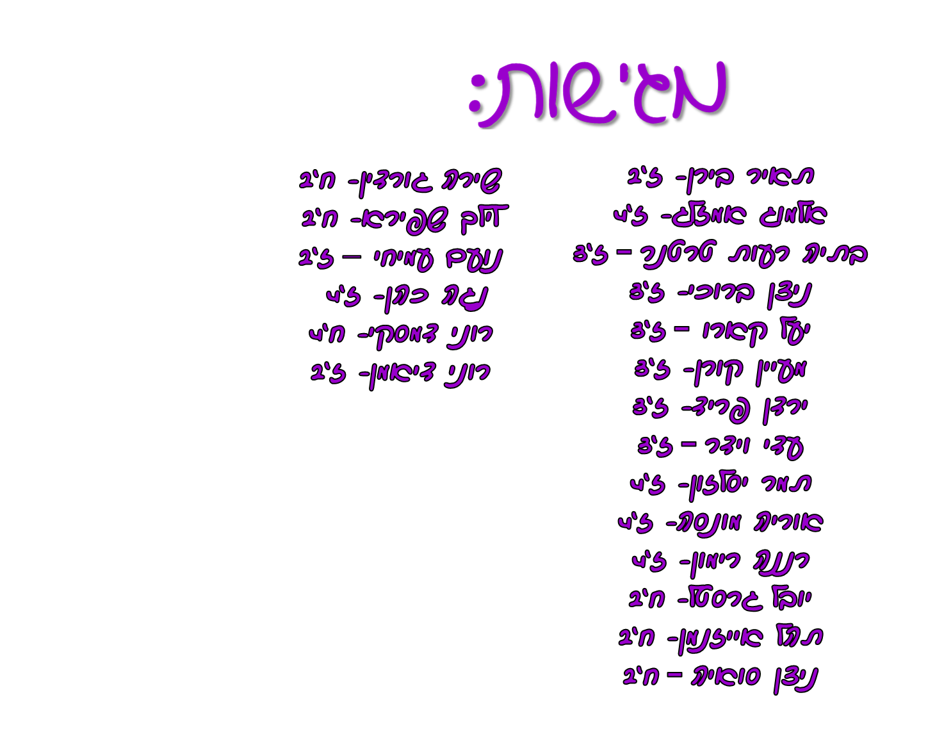

Slide 22
Lunar scientists plan for sustainable and affordable moon base- impactlab.net
Nuclear power production at moon and Mars- mymusicstreets.com
What do we do there?- Vissions 2200\ Space luna do
Ynet מדע ותרבות
הידען
ויקיפדיה- lunar water
-ויקיפדיה- LCROSS
marker
lcrosshttp://www.fenergy.co.il/
www.fenergy.co.il
Mining the moon's water: Q & A with Shackleton Energy's Bill Stone- space.com
How moon dust could yeald oxygen, fuel and water- space.com
Volatile content of lunar volcanic glasses and the presence of water in the moon's interior- Nature 454, 192-195 (july 2008).
How NASA hopes to mine water on the moon- space.com

Slide 23
Mining lunar polar ice – adsabs.harvard.edu
Microwaving moondust- COMSOL.com
Mining the moon- searchanddiscovery.com
How astronauts could harvest water on the moon- newscientist.com
Using microwaves to extract water from the moon-science20.com
Microwaving moondust with COMSOL- deskeng.com
Ice on the moon- nssdc.gsfc.nasa.gov
Moon water- our ticket to the solar system – synapses.co.uk
Nuclear power production at moon and Mars- mymusicstreets.com
What do we do there?- Vissions 2200\ Space luna do

Slide 24
מקורות מידע נוספים:
Colonization of Space Looms --Nuclear Power Plant for Settlements on Moon, Mars & Beyond
daily galaxy.com
NASA may build nuclear reactors on moon and mars- greenoptimistic.com
NASA to build miniature nuclear power station on the Moon and Mars
-activenet.com
Nuclear Reactors for Space- world- nuclear.org
Why do researchers&space enthusiasts see helium 3 as a viable energy source?

Slide 25
Read more: Why do researchers&space enthusiasts see helium 3 as a viable energy
source? | Answerbaghttp://www.answerbag.com/q_view/1900866#ixzz1dtDS7VBv
helium3-wikipedia
Race to the Moon for Nuclear Fuel- wired.com
Helium-3 Power Generation- explaining the future.con
Fusion Power from the Moon- asi.org
lunar helium 3 as an energy sourse in a nutshell –asi.org
mining the moon -
http://www.popularmechanics.com/science/space/moon-mars/1283056
נסיונות מוצלחים בכור היתוך גרעיני - blog.k1789.com
היתוך גרעיני – energianews.com

Slide 26
FOXNEWS.com - NASA Wants to Mine Moon Water
,הירח, התפרצות סולארית, מופעי הירח- ויקיפדיה
Wikipedia - lunar terminator, peary crater, Shackleton crater)
Selenographiccolongitude
Robert Perry
C:\ 3\Can you melt ice in a microwave oven - BT3Central Forums.htm
http://findarticles.com/p/articles/mi_m3289/is_n3_v161/ai_12374649/
Interaction of microwave irradiation with material- microwvetec.com
http://www.microwavetec.com/theor_basics.php
JOURNAL OF GEOPHYSICAL RESEARCH, VOL. 105, NO. E5, PAGES 12,023-12,03
3, MAY 25, 2000 Lunar polar topography derived from Clementine stereoimages
A. C. Cook,• T. R. Watters,• M. S. Robinson2, P. D. Spudis3, and D. B. J. Bussey4
PERMANENTLY SHADOWED AREAS AT THE LUNAR POLES: NATURE AND POSSIBLE
UNILIZATION.
V.V.Shevchenko, E.A.Kozlova, Sternberg State Astronomical Institute, Moscow University, 13
Universitetsky pr., 119992 Moscow, Russia;
RoI - Peary Crater - http://www.wikispaces.com/
Prime Moonbase Locations - Visions 2200 - A Perspective on the Future

Slide 27
Lack of exposed ice inside lunar south pole Shackleton Crater - Spacespin.com
- Using Microwaves to Heat Lunar SoilIEEE Spectrum and ComsolMicrowave Heating WebinarFebruary 10, 2011Edwin Ethridge, PhD Materials & Processes LaboratoryNASA-MSFC-EM41, Huntsville, AL
International Journal of Solar System Studies (1994)
Volume: 111, Issue: 2, Pages: 441-455
Available from adsabs.harvard.edu
Using COMSOL Multiphysics Software to Model
Anisotropic Dielectric and Metamaterial Effects
in Folded-Waveguide Traveling-Wave
Tube Slow-Wave Circuits- David P. Starinshak and Nathan D. Smith
Ohio Aerospace Institute, Brook Park, Ohio
Jeffrey D. Wilson
Glenn Research Center, Cleveland, Ohio

Slide 28
Mini Nuclear Reactors Could Power Space Colonies- http://www.universetoday.com
E-Cat: Suitcase Cold Fusion Nuclear Reactor ? - http://inpursuitofhappiness.wordpress.com/
NASA has new hopes, challenges with moonshot - cnet.com
LOLA Featured Image - Peary Crater
Ice at the north of the moon- air and space Smithsonian
Visions 2200 - A Perspective on the Future- Prime Moonbase Locations
Related researchInternational Journal of Solar System Studies (1994)
Volume: 111, Issue: 2, Pages: 441-455
Radiation Shielding for a Lunar Base-
Final Report
Jared Bell
Dustin Lail
Chris Martin
Paul Nguyen
May 10, 2011
http://www.jamesoberg.com/astronomy_moonpole.pdf

